Slide 1
CSC 3210 Computer Organization and Programming
Chapter 1 Basic Concepts
Dr. Zulkar Nine
mnine@gsu.edu
Georgia State University
Spring 2021

Slide 2
Outline
Welcome to Assembly Language
Some concerns
Applications
Virtual Machine Concepts
Virtual Machines
Machine Levels
Translating Language
Data Representation
Boolean Operations

Slide 3
Welcome to Assembly language!
Programming is fun!

Slide 4
What is an assembler, a linker, a debugger?
Intel Assembly code
Source
File
Assembler
Object
File
Intel Machine Language:
A1 00000000
F7 25 00000004
03 05 00000008
E8 00500000
mov eax,A
mul B
add eax,C
call WriteInt
Source
File
Assembler
Object
File
Linker
Executable
File
Source
File
Assembler
Object
File
Link
Libraries
debugger

Slide 5
Some issues
What hardware/software do I need?
Computer 32/64 bit
Windows + Microsoft Visual Studio
Mac + Virtualization software (Virtualbox) + Windows + Microsoft Visual Studio
What types of programs will I create?
Mainly 32-Bit, Some 64 bit
What do I get with this book?
http://www.asmirvine.com/

Slide 6
More issues
How does assembly language (AL) relate to machine language?
One-to-one relationship
How do C/C++ relates to AL?
C/C++
Is AL portable? No. Why?
Assembly
int Y;
int X = (Y + 4) * 3;
mov eax,Y ; - move Y to the EAX register
add eax,4 ; - add 4 to the EAX register
mov ebx,3 ; - move 3 to the EBX register
imul ebx ; - multiply EAX by EBX
mov X,eax ; - move EAX to X

Slide 7
Assembly Language Applications
Some representative types of applications:
Hardware device driver
Embedded systems & computer games
Business application for single platform (No)
Business application for multiple platforms (No)

Slide 8
Think again!
Is the assembly language for x86 processors the same as those for computer systems such as the Vax, Motorola 68x00, or SPARC?
SPARC
Intel
mov 5,r1
mov 6,r2
add r1,r2,r3
mov eax,5
add eax,6

Slide 9
What’s Next
- Welcome to Assembly Language
Some Good Questions to Ask
Assembly Language Applications
- Virtual Machine Concept
Virtual Machines
Specific Machine Levels
Translating Languages
- Data Representation
- Boolean Operations

Slide 10
Virtual Machine Concepts
Abstraction that hides all the low level complexities

Slide 11
Specific Machine Levels
Virtual Machine Concept
Explain how a computer’s hardware and software are related.
The main thing a computer does is executing programs
A computer execute programs written in its native machine language (ML).
difficult to write programs in ML
What to do?
programs could be written in another language (Interpretation vs. Translation)

Slide 12
Specific Machine Levels: High-Level Language
Level 5
Application-oriented languages
C++, Java, Visual Basic . . .
Programs compile into assembly language (Level 4)

Slide 13

Specific Machine Levels: High-Level Language
High-level language program (in C)
void main()
{
C = ( Y + 4 ) * 3 ;
}
C Compiler
mov eax, Y
add eax, 4
mov ebx, 3
imul ebx
mov C, eax
Assembly language program
Assembler
Linker
00000000100011100001100000100001
10001100011000100000000000000000
10001100111100100000000000000100
10101100111100100000000000000000
00000011111000000000000000001000
Binary machine language program

Slide 14
What's Next
- Welcome to Assembly Language
Some Good Questions to Ask
Assembly Language Applications
- Virtual Machine Concept
Virtual Machines
Specific Machine Levels
Translating Languages
- Data Representation
- Boolean Operations

Slide 15
Data Representation
Lots of math!

Slide 16
Data Representation
Binary Numbers
Translating between binary and decimal
Binary Addition
Integer Storage Sizes
Hexadecimal Integers
Translating between decimal and hexadecimal
Hexadecimal subtraction
Signed Integers
Binary subtraction
Character Storage

Slide 17
Data Representation: Numbering System
Assembly language deals with Data at the physical level
so you need to examine registers and memory
Binary and hexadecimal numbers are commonly used to describe those contents (other systems used as well)
Need to learn how to translate from one format to another
Base: maximum number of symbols assigned to every digit
Notes:
MW, 23 Aug

Slide 19
Data Representation: Binary Numbers (Integers)
Binary integers can be signed or unsigned.
A signed integer is positive or negative.
An unsigned integer is by default positive.
Zero is considered positive.

Slide 20
Data Representation: Binary Numbers (Integers)
Digits are 1 and 0
1 = true
0 = false
MSB – most significant bit
LSB – least significant bit
Bit numbering:

Slide 21
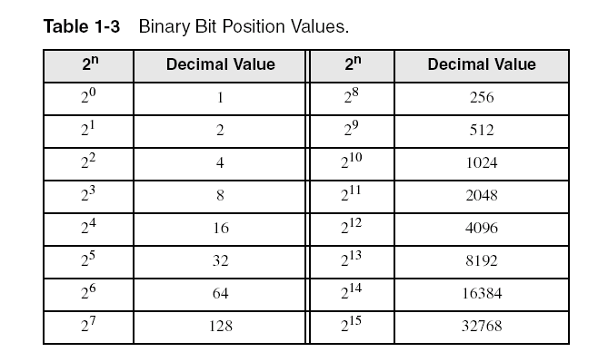
Data Representation: Binary Numbers (Integers)
Each digit (bit) is either 1 or 0
Each bit represents a power of 2:
Every binary number is a sum of powers of 2

Slide 22
Data Representation: Translating Binary to Decimal
Weighted positional notation shows how to calculate the decimal value of each binary bit:
dec = (D_{n-1} × 2^{n-1}) + (D_{n-2} × 2^{n-2}) + ... + (D₁ × 2¹) + (D₀ × 2⁰)
D = binary digit
binary 00001001 = decimal 9:
(1 × 2³) + (1 × 2⁰) = 9

Slide 23
Data Representation: Translating Binary to Decimal

Slide 24
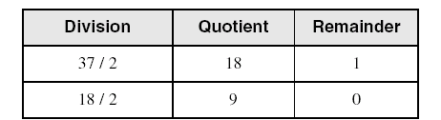
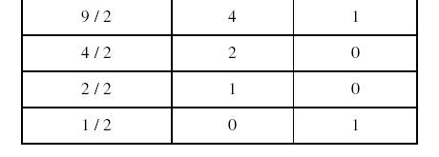
Data Representation: Translating Unsigned Decimal to Binary
Repeatedly divide the decimal integer by 2.
Each remainder is a binary digit in the translated value:
37 = 100101

Slide 25
Data Representation: Binary Addition
Starting with the LSB, add each pair of digits, include the carry if present.

Slide 26
Data Representation: Integer Storage Sizes
Standard sizes (x86):
What is the largest unsigned integer that may be stored in 20 bits?

Slide 28
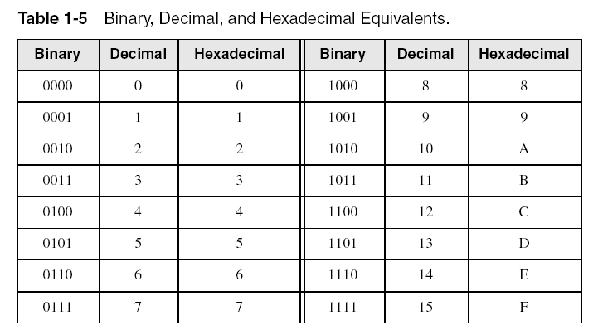
Data Representation: Hexadecimal Integers
Binary values are represented in hexadecimal (Why).
Large binary numbers are hard to read

Slide 29
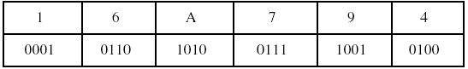
Data Representation: Translating Binary to Hexadecimal
Each hexadecimal digit corresponds to 4 binary bits (Why?).
Example: Translate the binary integer
000101101010011110010100
to hexadecimal:

Slide 30
Data Representation: Converting Hexadecimal to Decimal
Multiply each digit by its corresponding power of 16:
dec = (D₃ × 16³) + (D₂ × 16²) + (D₁ × 16¹) + (D₀ × 16⁰)
Hex 1234 equals (1 × 16³) + (2 × 16²) + (3 × 16¹) + (4 × 16⁰), or decimal 4,660.
Hex 3BA4 equals (3 × 16³) + (11 * 16²) + (10 × 16¹) + (4 × 16⁰), or decimal 15,268.

Slide 31
Data Representation: Converting Hexadecimal to Decimal

Slide 32
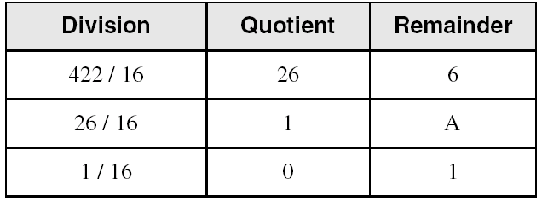
Data Representation: Converting Decimal to Hexadecimal
decimal 422 = 1A6 hexadecimal

Slide 33
Data Representation: Hexadecimal Addition
Divide the sum of two digits by the number base (16). The quotient becomes the carry value, and the remainder is the sum digit.
1
1
36 28 28 6A
42 45 58 4B
78 6D 80 B5
21 / 16 = 1, rem 5
Important skill: Programmers frequently add and subtract the addresses of variables and instructions.

Slide 34
Data Representation: Hexadecimal Subtraction
When a borrow is required from the digit to the left, add 16 (decimal) to the current digit's value:
16 + 5 = 21
−1
C6 75
A2 47
24 2E
Notes:
0000004A → 74 bytes or 1 byte?

Slide 35
Data Representation: Signed Integers
Challenges -
Dealing with both positive and negative numbers
Simplify the Circuit design

Slide 36
Data Representation: Signed Integers
The highest bit indicates the sign. 1 = negative, 0 = positive
If the highest digit of a hexadecimal integer is > 7, the value is negative. Examples: 8A, C5, A2, 9D
Notes:
Sec06 Week2

Slide 37
Data Representation: Forming the Two's Complement
Negative integer numbers are stored in two's complement notation, (Why?)
Removes the need to separate digital circuits for addition and subtraction
When subtracting A – B, processor will convert it to an addition expression
A + (-B)

Slide 39
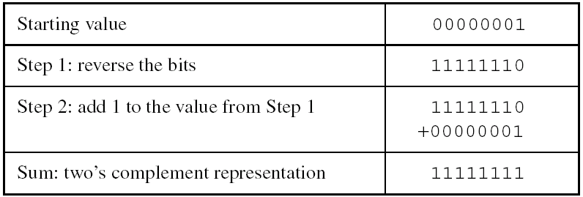
Data Representation: Forming the Two's Complement
Negative integer numbers are stored in two's complement notation
Represents the additive Inverse
Algorithm
First: represent the negative number in binary
Second: do One’s complement:
Replace every 0 with a 1,
and replace every 1 with a 0
Third: do Two’s complement: add 1
Fourth: represent the second number in binary
Fifth: add the two numbers
Note that 00000001 + 11111111 = 00000000

Slide 41
Data Representation: Binary Subtraction
When subtracting A – B, convert B to its two's complement
A + (-B)
A: 0 0 0 0 1 1 0 0 A: 0 0 0 0 1 1 0 0
B: (-) 0 0 0 0 0 0 1 1 2’s complement of B: (+) 1 1 1 1 1 1 0 1
(where is the carry?) 0 0 0 0 1 0 0 1
Notes:
Stoped here sec 02 17/1/

Slide 42
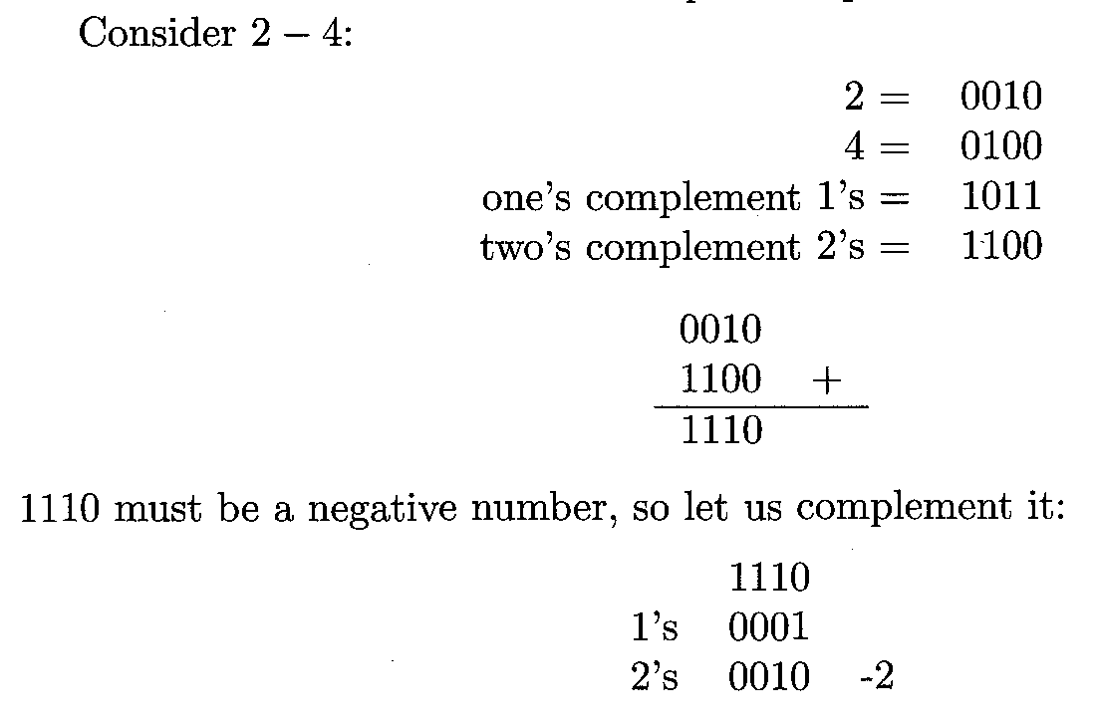
Data Representation: Binary Subtraction
What if the result is a negative number?
- convert the negative number to its positive equivalent
Notes:
Stoped here sec 02 17/1/

Slide 43
Data Representation: Learn How To Do the Following:
Form the two's complement of a hexadecimal integer (page 16)
Convert signed binary to decimal (page 17)
Convert signed decimal to binary (page 17)
Convert signed decimal to hexadecimal (page 17)
Convert signed hexadecimal to decimal (page 17)
You must know these conversions!

Slide 44
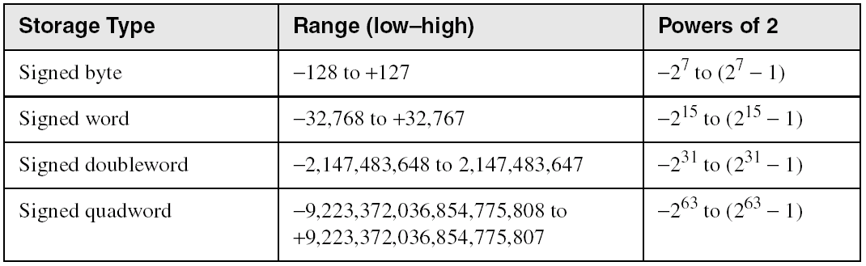
Data Representation: Ranges of Signed Integers
The highest bit is reserved for the sign. This limits the range:
Practice: What is the largest positive value that may be stored in 20 bits?

Slide 46
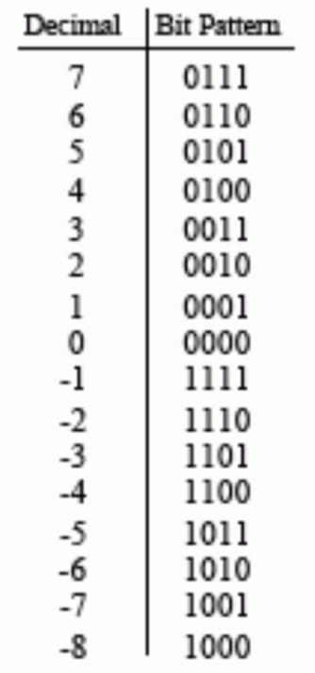
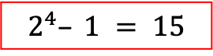
Data Representation: Signed Integers
List all the Four-bit two’s complement numbers:
Total numbers can be stored :
Binary | Unsigned value
0000 | 0
0001 | 1
0010 | 2
0011 | 3
0100 | 4
0101 | 5
0110 | 6
0111 | 7
1000 | 8
1001 | 9
1010 | 10
1011 | 11
1100 | 12
1101 | 13
1110 | 14
1111 | 15
Signed value
0
1
2
3
4
5
6
7
-8
-7
-6
-5
-4
-3
-2
-1
$$2^{4}– 1 = 15$$

Slide 47
Data Representation: Character Storage
Computers only store binary data, how do they represent characters?
Character sets (a mapping of characters to integers)
Standard ASCII (0 – 127)
Extended ASCII (0 – 255)
ANSI (0 – 255)
Unicode (0 – 65,535)
Null-terminated String
Array of characters followed by a null byte
Using the ASCII table
ASCII (American Standard Code for Information Interchange) maps each character to a specific number (decimal, hexadecimal, and bit pattern)
Notes:
June 8th, Thursday

Slide 48
ASCII

Slide 49
Data Representation: Numeric Data Representation
Pure binary
can be calculated directly
ASCII binary
string of digits: "0 1 1 0 0 0 0 1” , character “a”
ASCII decimal
string of digits: ”97” a
ASCII hexadecimal
string of digits: ”61” a

Slide 50
What's Next
- Welcome to Assembly Language
Some Good Questions to Ask
Assembly Language Applications
- Virtual Machine Concept
Virtual Machines
Specific Machine Levels
Translating Languages
- Data Representation
- Boolean Operations

Slide 51
Boolean Operations
The world of logic

Slide 52
Boolean Operations
NOT
AND
OR
Operator Precedence
Truth Tables

Slide 53
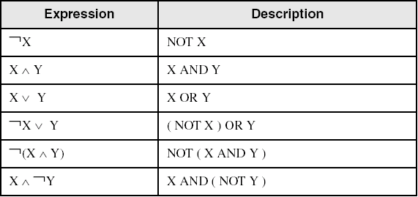
Boolean Operations: Boolean Algebra
Based on symbolic logic, designed by George Boole
Boolean expressions created from:
NOT, AND, OR

Slide 54
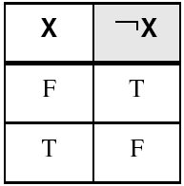
Boolean Operations: NOT
Inverts (reverses) a boolean value
Truth table for Boolean NOT operator:
Digital gate diagram for NOT:
The NOT operator is a UNARY operator (i.e. it acts on one variable or expressions)

Slide 55
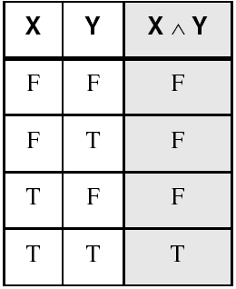
Boolean Operations: AND
Truth table for Boolean AND operator:
Digital gate diagram for AND:
AND operator is a BINARY operator (i.e. it acts on two variables or expressions – “binary” in this context does not mean “base-2”)

Slide 56
Attendance!

Slide 57
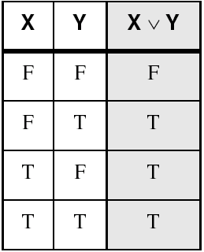
Boolean Operations: OR
Truth table for Boolean OR operator:
Digital gate diagram for OR:
The OR operator is a BINARY operator (i.e. it acts on two variables or expressions)

Slide 58
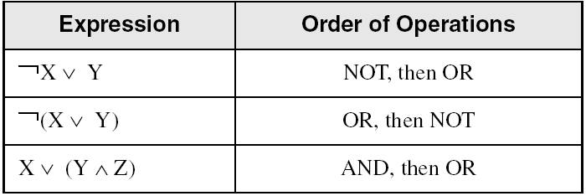
Boolean Operations: Operator Precedence
Examples showing the order of operations:

Slide 59
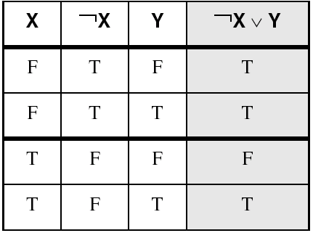
Boolean Operations: Truth Tables
A Boolean function has one or more Boolean inputs, and returns a single Boolean output.
A truth table shows all the inputs and outputs of a Boolean function
Example: ¬X ∨ Y

Slide 60
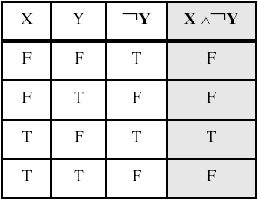
Boolean Operations: Truth Tables
Example: Z = ?
Z

Slide 63
Boolean Operations: Multiplexer
Multiplexer:
A data selector. Multiplexers can also be used to implement Boolean functions of multiple variables.
Multiple-input, single-output
A multiplexer (or mux) is a common digital circuit
Two-input multiplexer
Two-input multiplexer

Slide 65
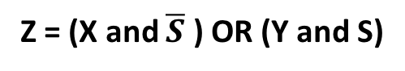
Boolean Operations: Truth Tables (Multiplexer)
S | X | Y | Z
0 | 0 | 0 | 0
0 | 0 | 1 | 0
0 | 1 | 0 | 1
0 | 1 | 1 | 1
1 | 0 | 0 | 0
1 | 0 | 1 | 1
1 | 1 | 0 | 0
1 | 1 | 1 | 1
X
Z
S
Y
Z = (X and $\overline{S}$ ) OR (Y and S)

Slide 66
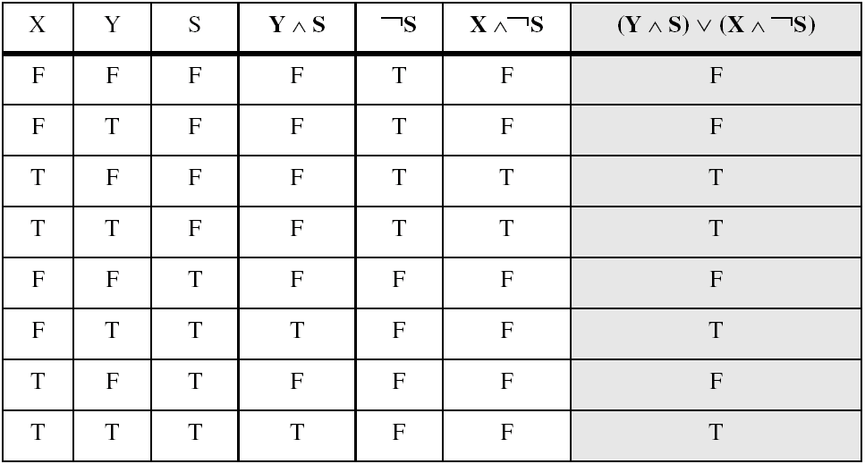
Boolean Operations: Truth Tables (Multiplexers)
Example: (Y ∧ S) ∨ (X ∧ ¬S)
Two-input multiplexer

Slide 67
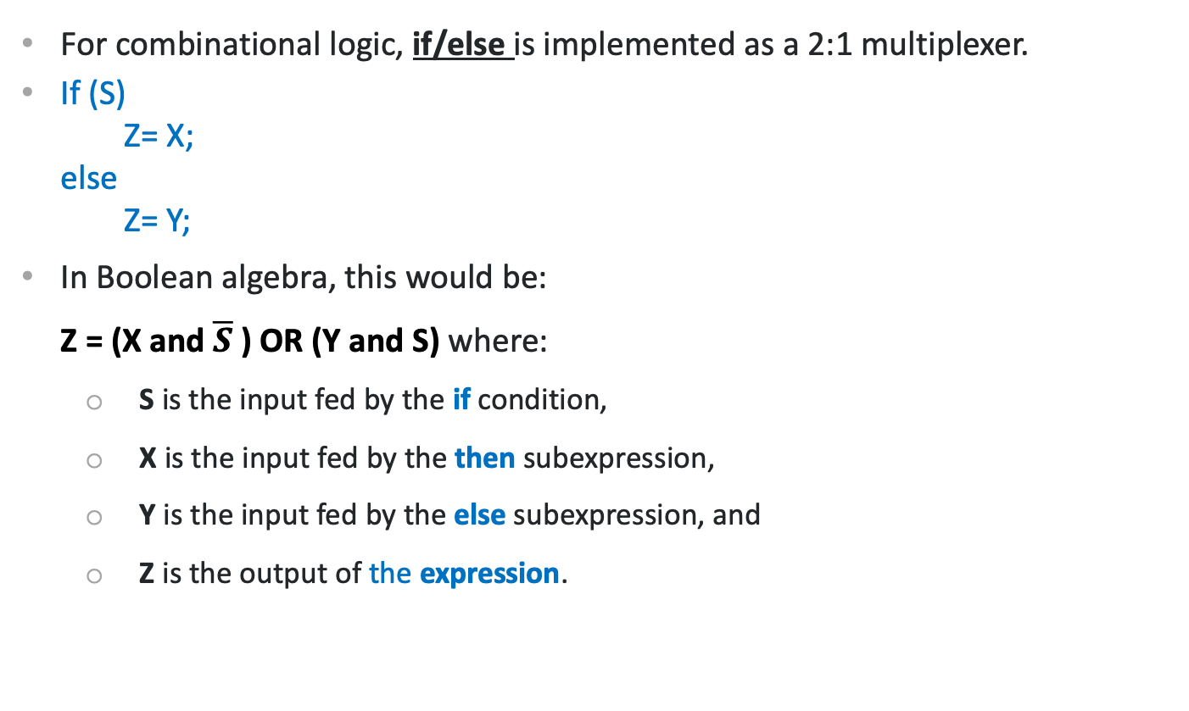
Boolean Operations: Truth Tables (Multiplexer)
For combinational logic, if/else is implemented as a 2:1 multiplexer.
If (S)
Z= X;
else
Z= Y;
In Boolean algebra, this would be:
Z = (X and $\overline{S}$ ) OR (Y and S) where:
S is the input fed by the if condition,
X is the input fed by the then subexpression,
Y is the input fed by the else subexpression, and
Z is the output of the expression.
X
Z
S
Y
Z = (X and $\overline{S}$ ) OR (Y and S)

Slide 68
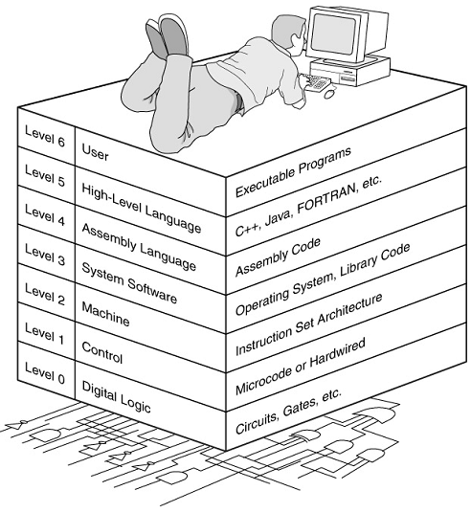
Boolean Operations: Truth Tables (Multiplexer)
X
Z
S
Y
Z = (X and $\overline{S}$ ) OR (Y and S)

Slide 69
Boolean Operations: Half and Full Adders

Slide 71
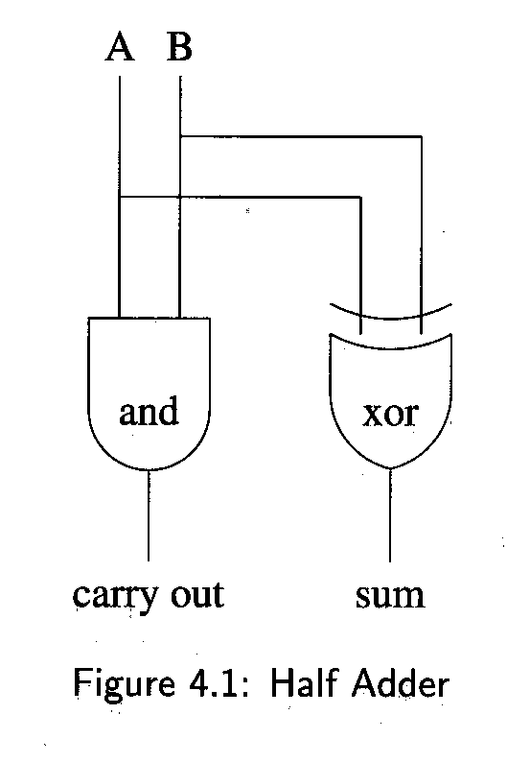
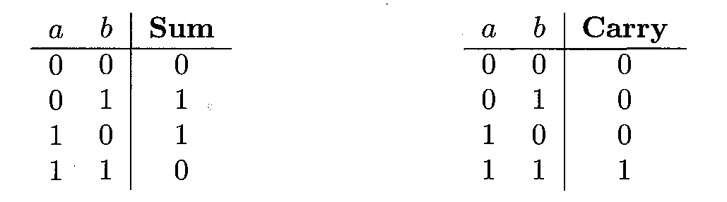
Boolean Operations: Half and Full Adders
Half Adder:
The generation of the sum and carry bits may be performed by very simple electronic circuits.
The generation of the sum and carry requires an and gate and an xor gate.
These may be obtained together in a circuit called a half adder
a | b | sum | carry
0 | 0 | 0 | 0
0 | 1 | 1 | 0
1 | 0 | 1 | 0
1 | 1 | 0 | 1
Exclusive or
and

Slide 72
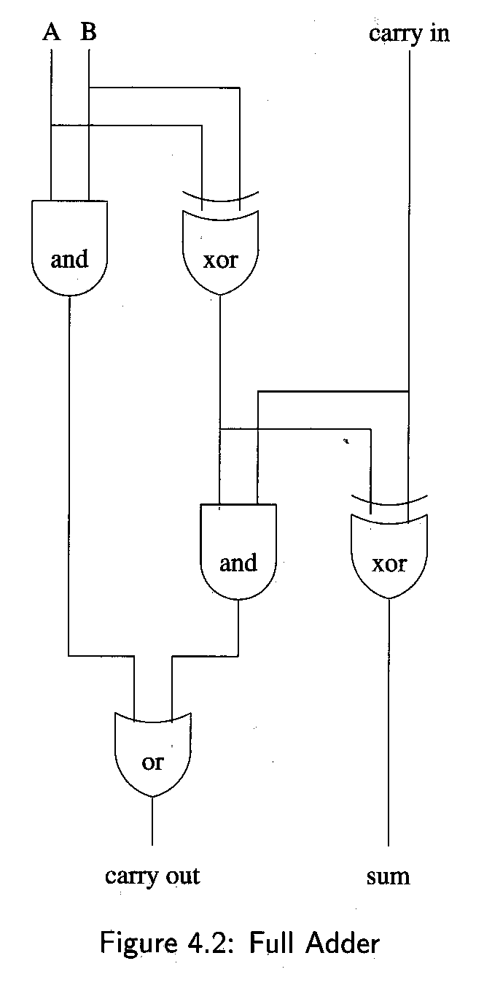
Boolean Operations: Half and Full Adders
Full Adder:
Two half adders may then be combined together with an or gate to add two inputs, A and B, with a carry in, to produce a sum and a carry out.
Such a circuit is called a full adder
1 + 1 + 1 = 1 and carry 1
Half adder cannot
handle this addition?

Slide 73
Boolean Operations: Half and Full Adders
Full Adder:

Slide 74
Summary
Assembly language helps you learn how software is constructed at the lowest levels
Assembly language has one-to-one relationship with machine language
Each layer in a computer's architecture is an abstraction of a machine
layers can be hardware or software
Boolean expressions are essential to the design of computer hardware and software

